Slide 1
Task Management
Restful API
Dr.Ahmad
Heba Aljedaya
Razan Hayajneh

Slide 2
Contents
01.
Application Features
02.
Demo
03.
Implementation app with flutter
04.
Implementation app with side serve

Slide 3
Task management
User Authentication.
Project Creation:
Task Management:
Team Collaboration.
Timeline Calendar:

Slide 4
Demo App

Slide 5
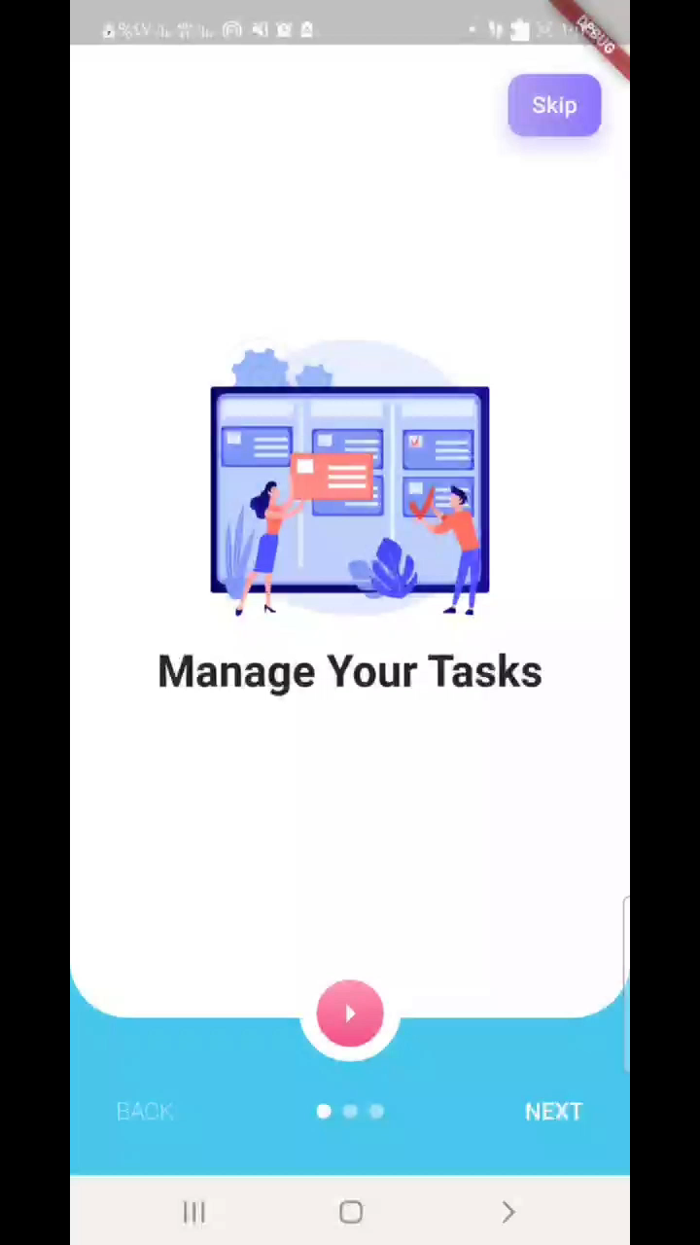
Demo application

Slide 6
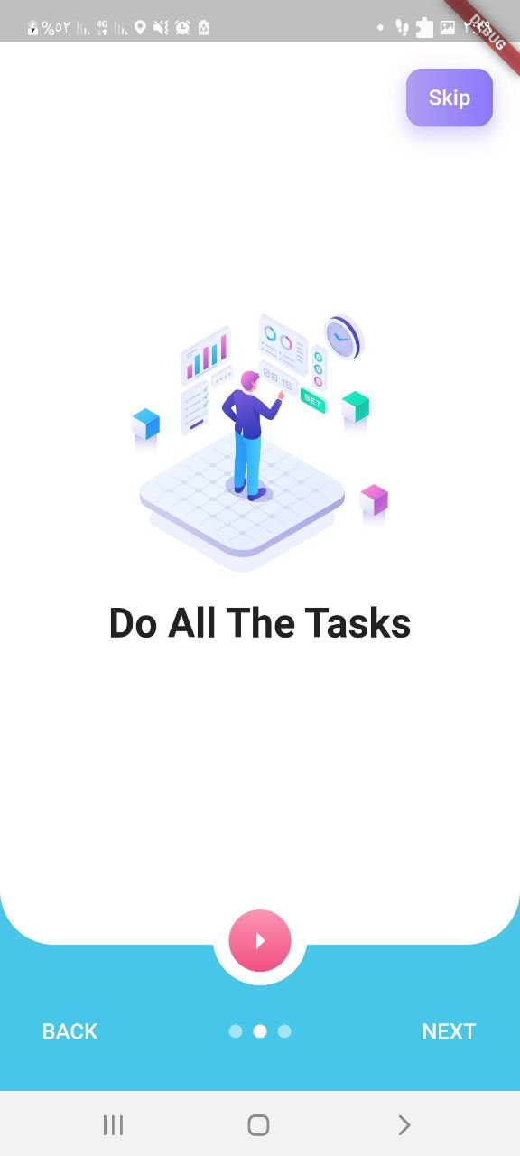
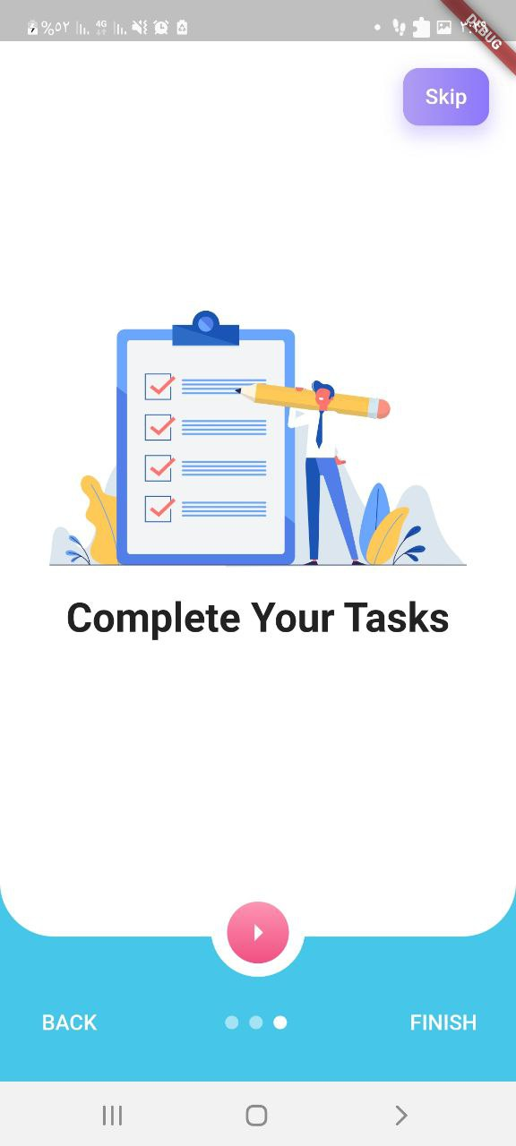

Slide 7
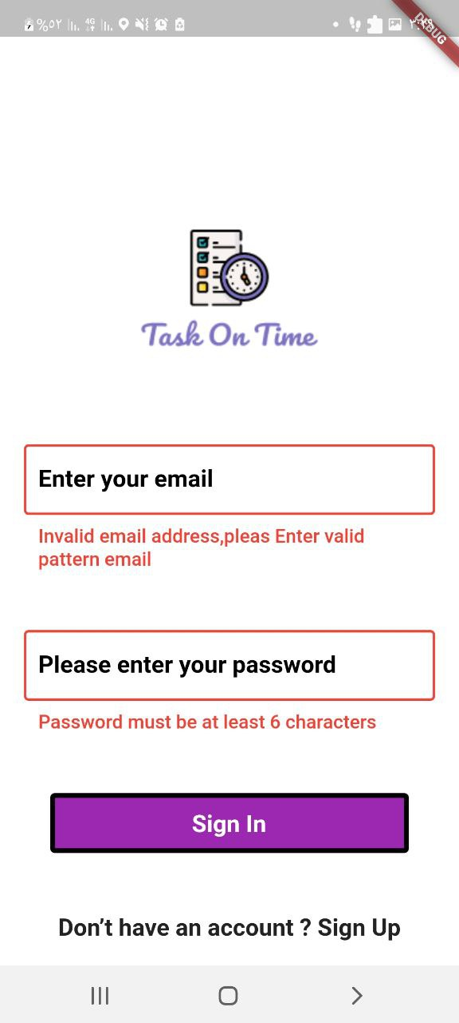
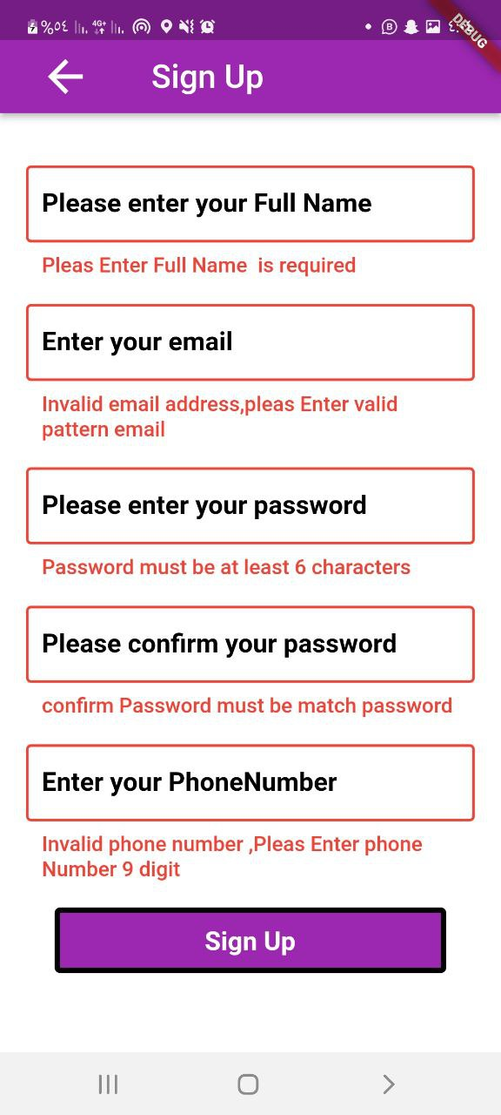
Sign Up and sign in a

Slide 8
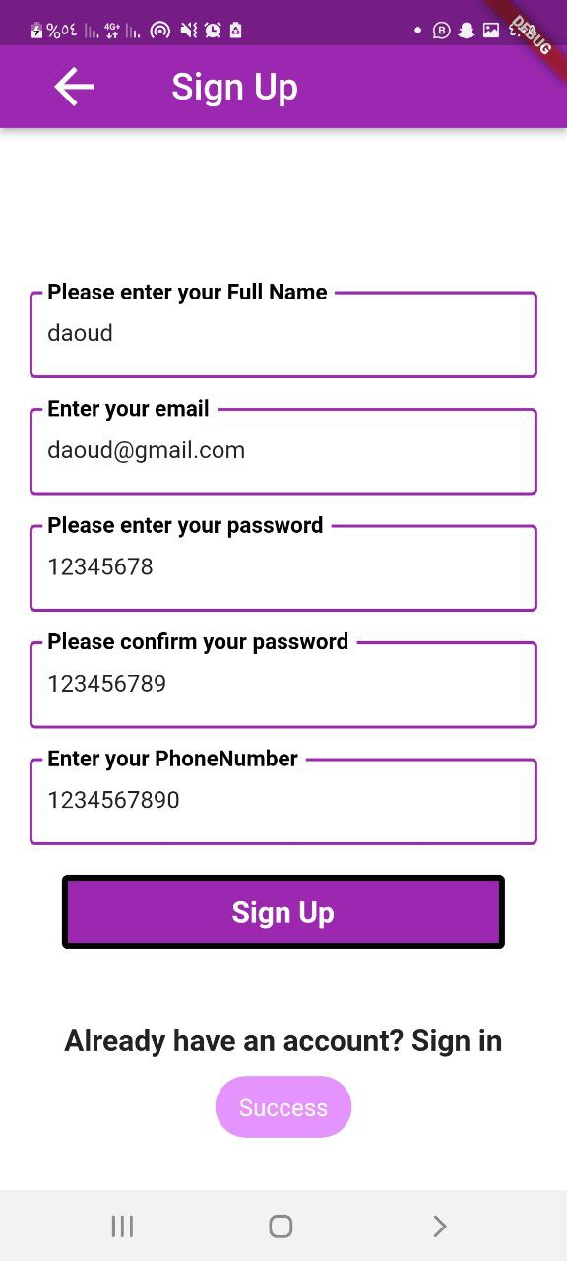

Slide 9
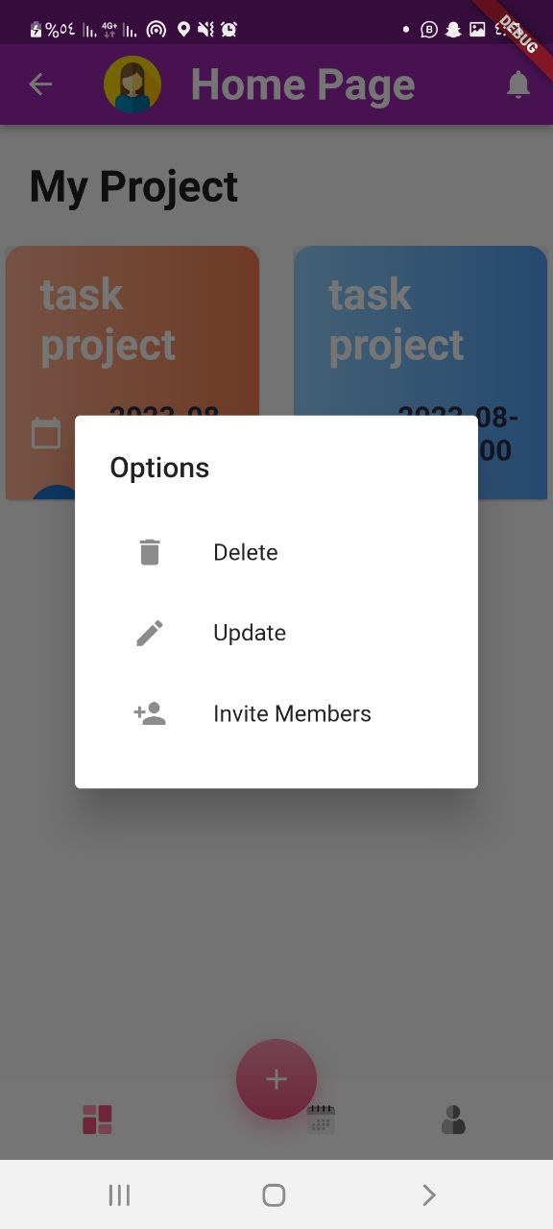
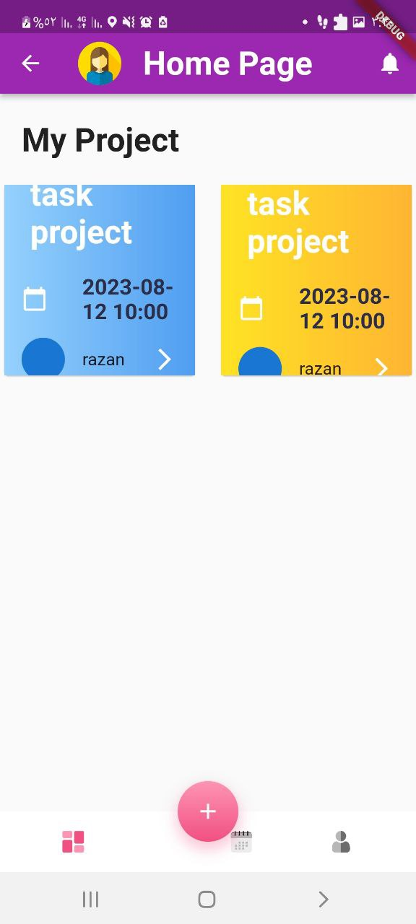

Slide 10
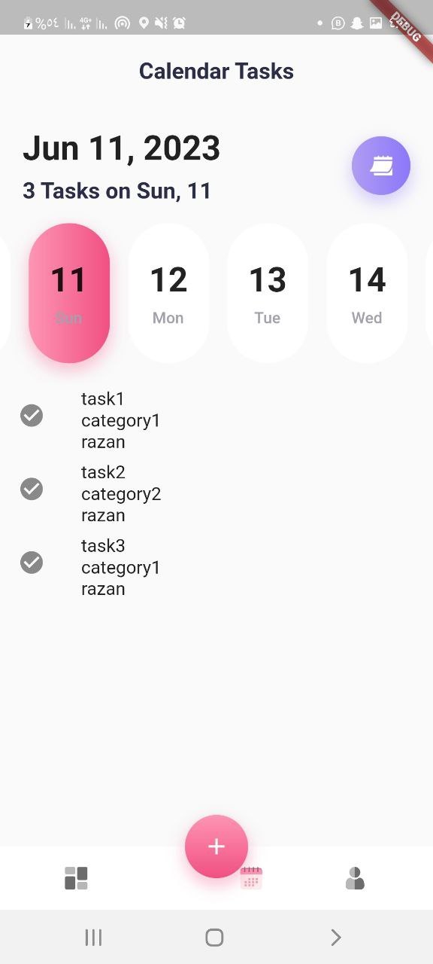

Slide 11
Demo website

Slide 12
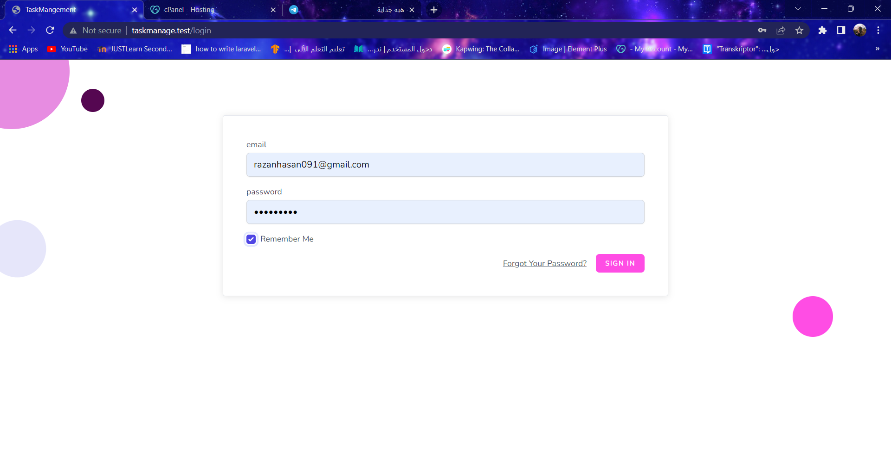

Slide 13
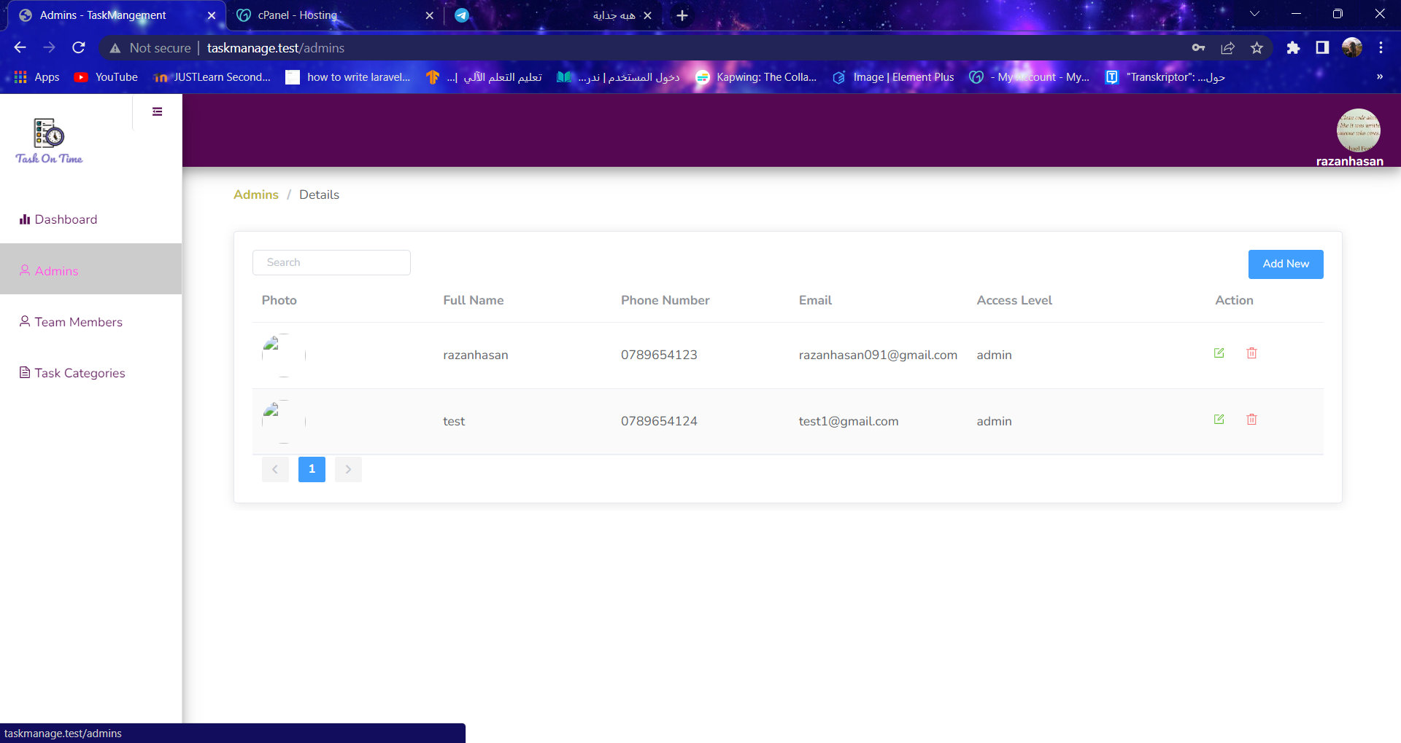

Slide 14
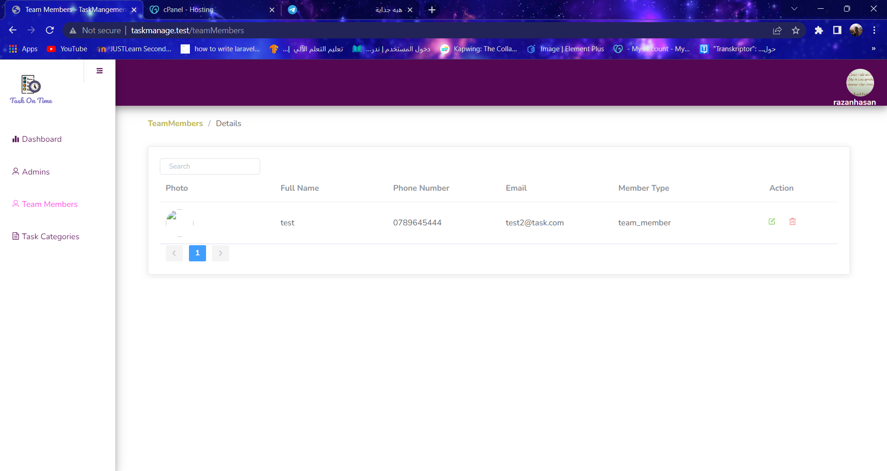

Slide 15
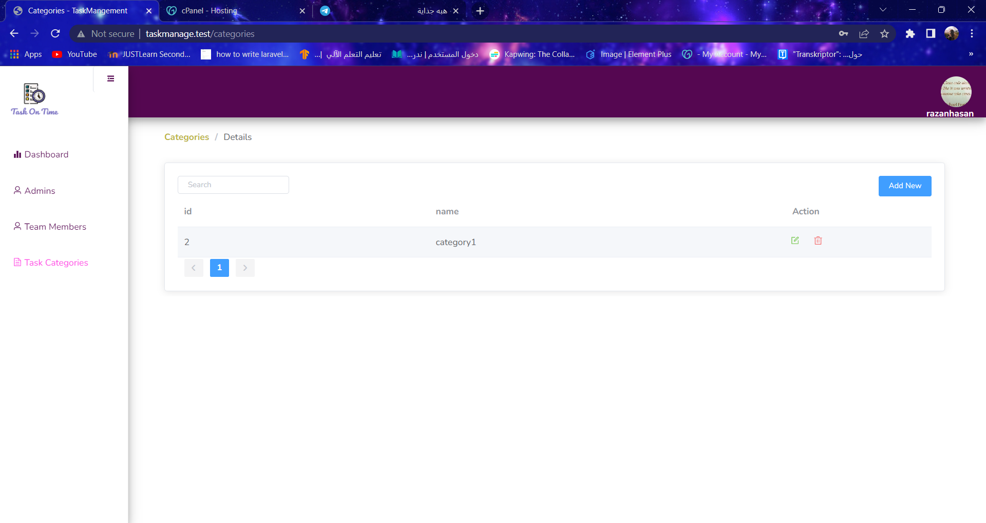

Slide 16
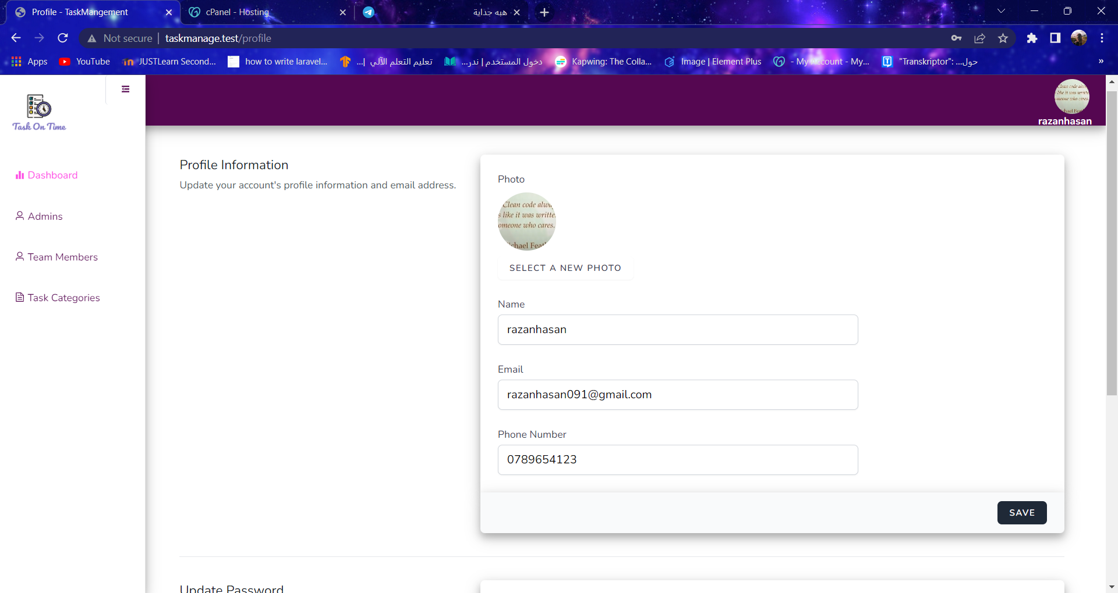

Slide 17
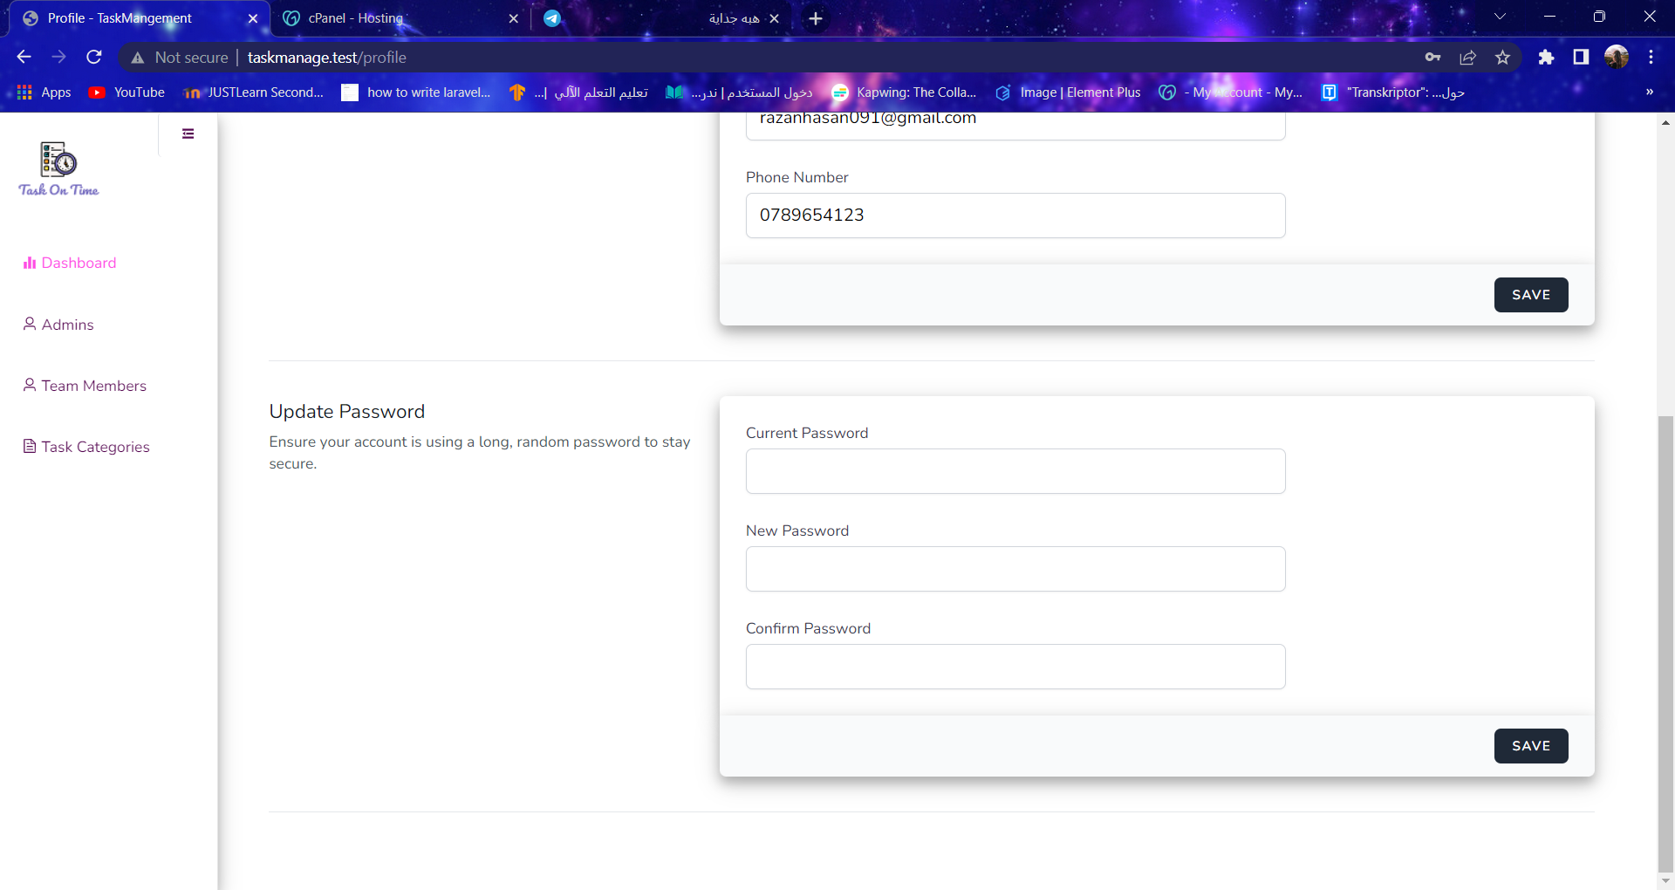

Slide 18
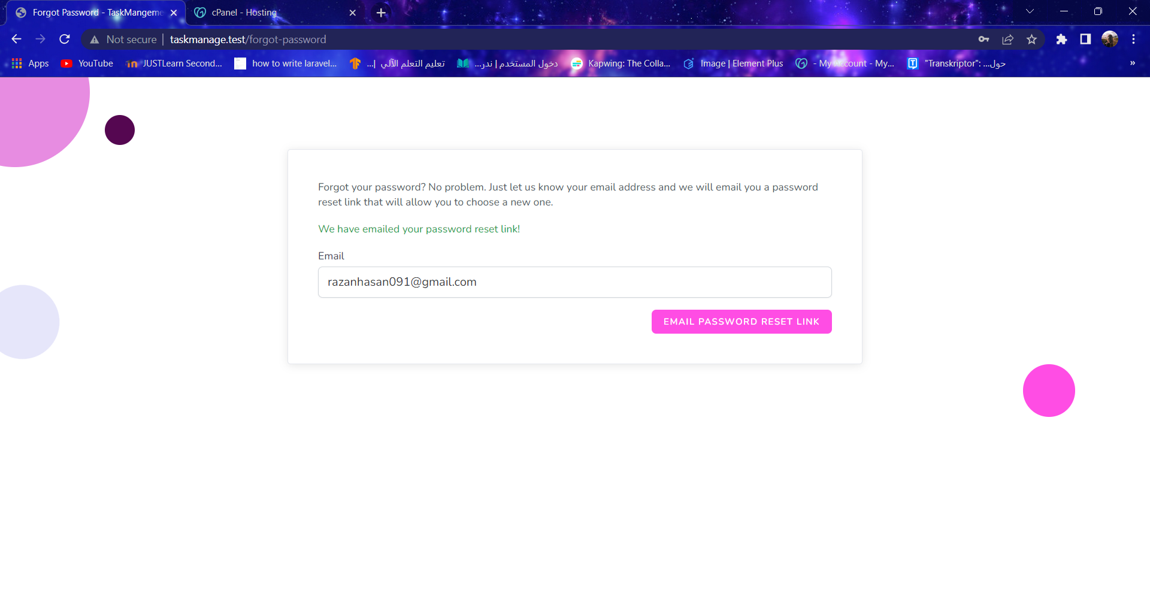

Slide 19
methodology
GoDaddy(CPanel Hosting)
http://taskmanagement.schooldemos.com/
For Database: MyPHPAdmin
Backend: using Laravel framework (PHP)
For Frontend:
Using Nodejs for admin application
Using Flutter for team member application

Slide 20
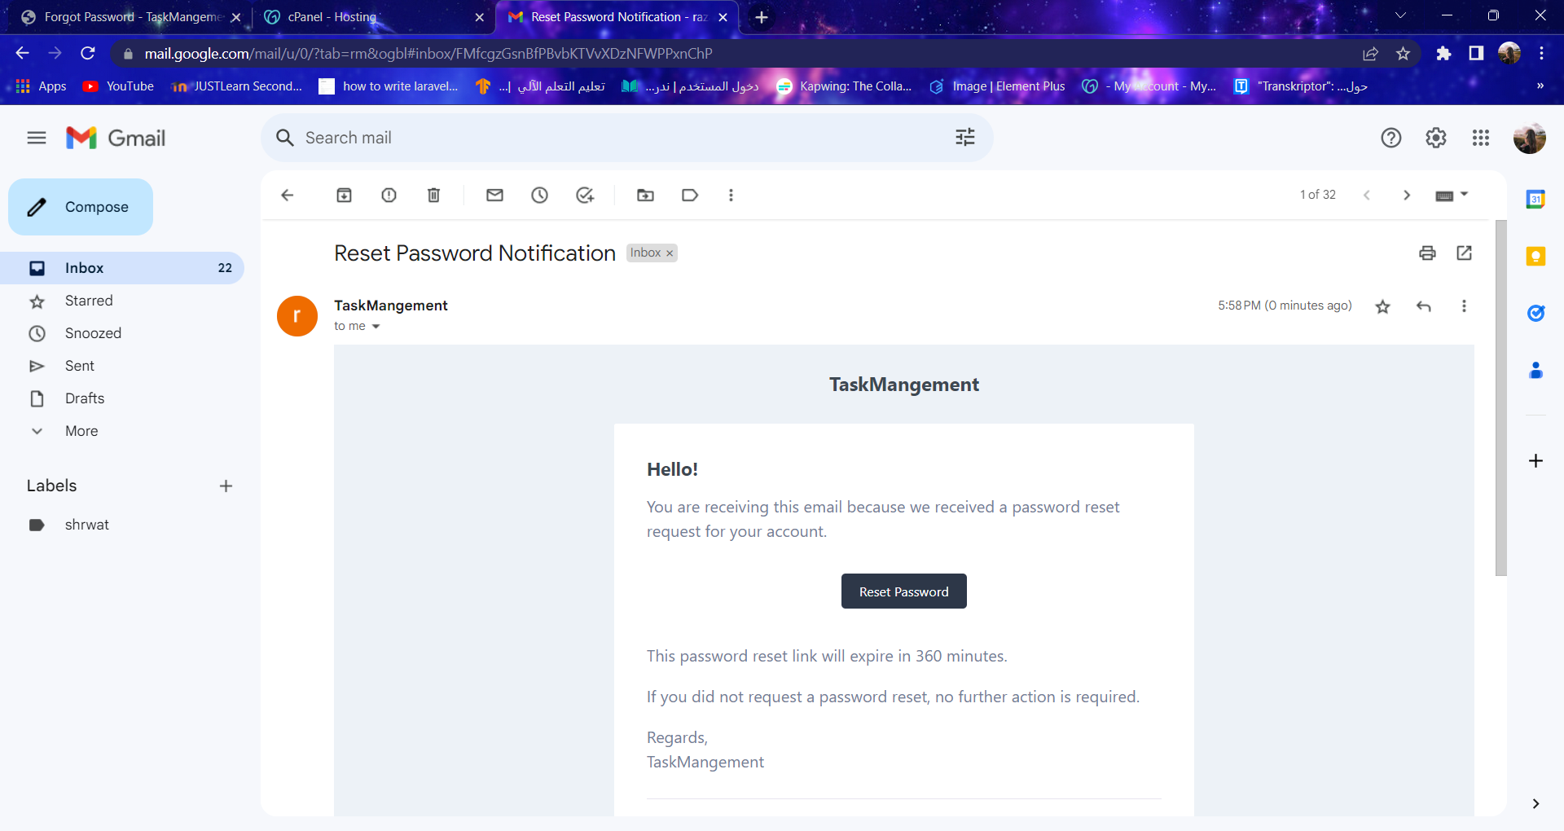

Slide 21
Implementation Project use Flutter

Slide 22
BLoC (Business Logic Component) is a design pattern used in Flutter for managing the state of an application. It stands for Business Logic Component because it separates the business logic from the UI components.

Slide 23
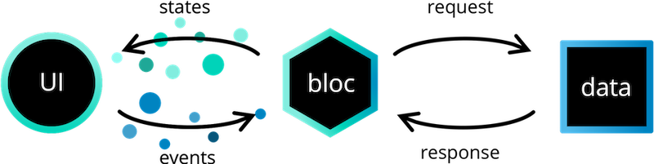

Slide 24
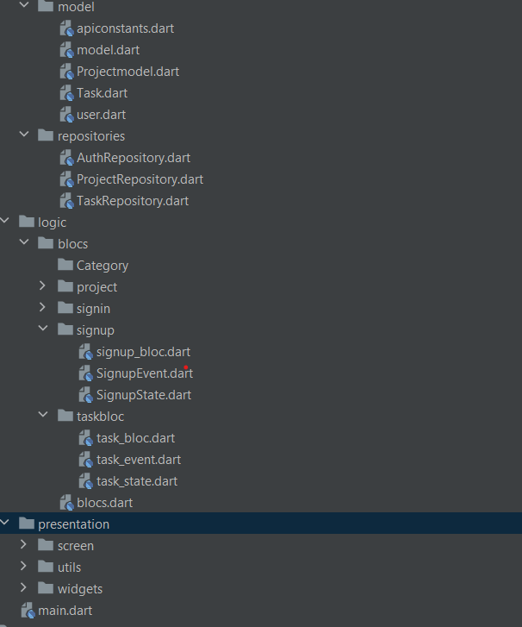
Architecture folder
As you can see in the lib folder, there is :
bloc folder: Responsible for managing the business logic
data folder: It has two folders model (Responsible for creating data model classes) and repositories (Responsible for making and manipulating the data).
presentation folder: Responsible for UI design
As you can see in the lib folder, there is :
bloc folder: Responsible for managing the business logic
data folder: It has two folders
model (Responsible for creating data model classes) and repositories (Responsible for making and manipulating the data).
presentation folder: Responsible for UI design

Slide 25
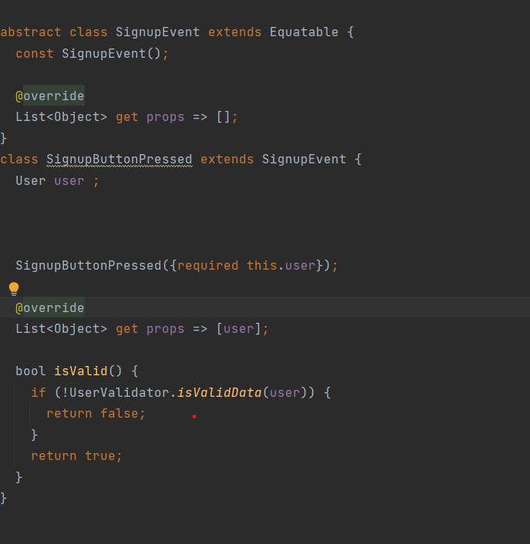
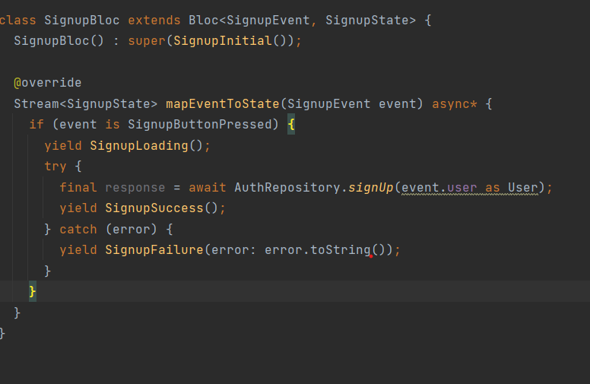
Event pass block

Slide 26
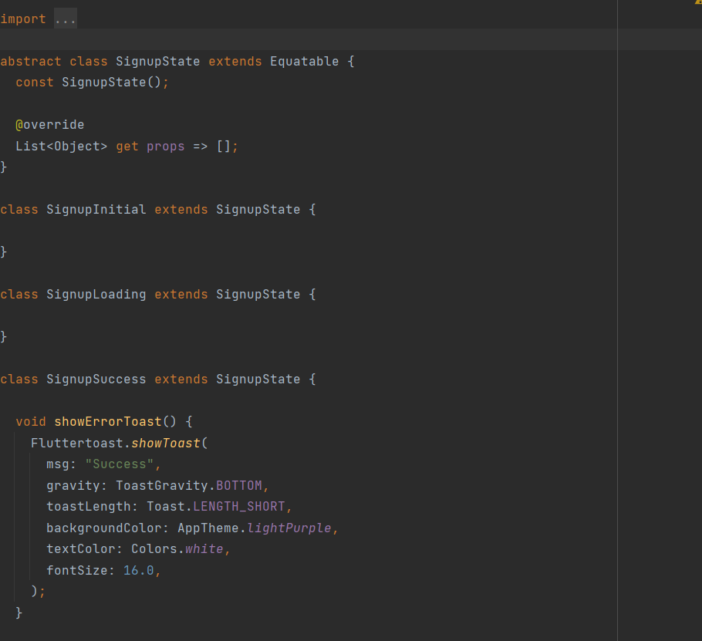
State

Slide 27
Provide bloc

Slide 28
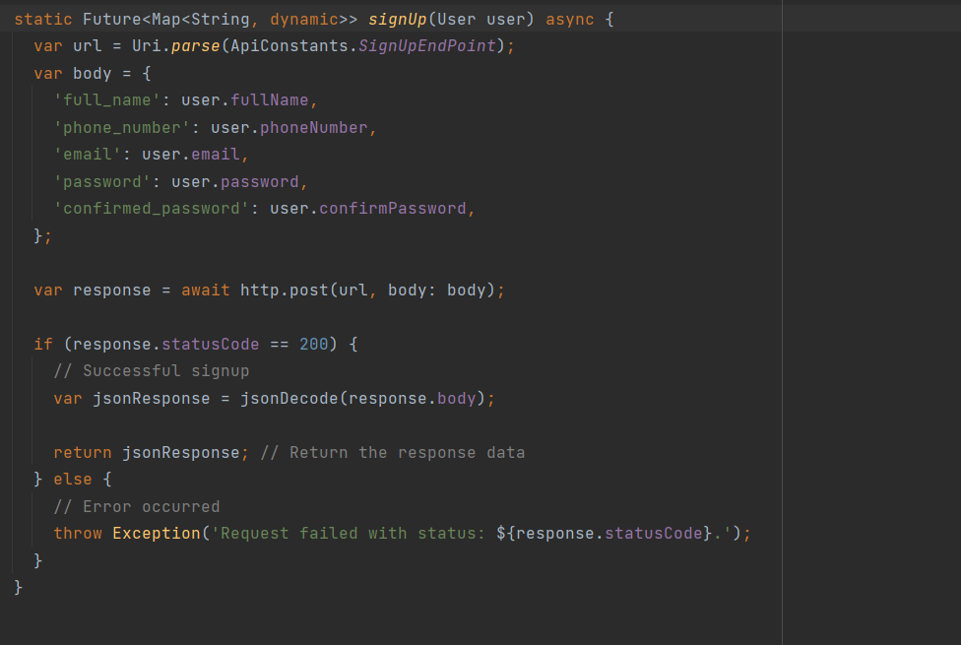
repositories

Slide 29
How to provide

Slide 30
Api details

Slide 31
RESTful API

Slide 32
RESTful APIs work
The user sends a request to the server.
The server authenticates the user and confirms that has the right to make that request
The server receives the request
The server returns a response to the user with the requested information if the request is successful

Slide 33
RESTful API request
Method:
GET|POST|PUT|DELETE
HTTP headers:
Data: for POST|PUT
Parameters: for URL
Authentication Methods:
Basic authentication: login/register
Bearer authentication: any other API such as get projects

Slide 34
RESTful API server response
Status line:
200: Generic success response
404: Resource not found
500: Server Error
Message body:
JSON formats: using in flutter project

Slide 35
WEB APIs
Method | URI | Name | Action
GET|HEAD | login | login | Laravel\Fortify\Http\Controllers\AuthenticatedSessionController@create
POST | login | login | Laravel\Fortify\Http\Controllers\AuthenticatedSessionController@store
GET|HEAD | forgot-password | password.request | Laravel\Fortify\Http\Controllers\PasswordResetLinkController@create
POST | forgot-password | password.email | Laravel\Fortify\Http\Controllers\PasswordResetLinkController@store
GET|HEAD | reset-password/{token} | password.reset | Laravel\Fortify\Http\Controllers\NewPasswordController@create
PUT | user/password | user-password.update | Laravel\Fortify\Http\Controllers\PasswordController@update
POST | logout | logout | Laravel\Fortify\Http\Controllers\AuthenticatedSessionController@destroy
GET|HEAD | dashboard | profile.show | App\Http\Controllers\Admin\DashboardController@index
GET|HEAD | profile |  | Closure
GET|HEAD | admins | admins.index | App\Http\Controllers\Admin\AdminController@index
POST | admins | admins.store | App\Http\Controllers\Admin\AdminController@store
GET|HEAD | admins/create | admins.create | App\Http\Controllers\Admin\AdminController@create
GET|HEAD | admins/{ admin }/ edit | admins.edit | App\Http\Controllers\Admin\AdminController@edit
PUT|PATCH | admins/{ admin } | admins.update | App\Http\Controllers\Admin\AdminController@update
DELETE | admins/{ admin } | admins.destroy | App\Http\Controllers\Admin\AdminController@destroy

Slide 36
WEB APIs
Method | URI | Name | Action
GET|HEAD | teamMembers | teamMembers.index | App\Http\Controllers\Admin\TeamMemberController@index
GET|HEAD | teamMembers/{teamMember}/ edit | teamMembers.edit | App\Http\Controllers\Admin\TeamMemberController@edit
PUT|PATCH | teamMembers/{ teamMember } | teamMembers.update | App\Http\Controllers\Admin\TeamMemberController@update
DELETE | teamMembers/{ teamMember } | teamMembers.destroy | App\Http\Controllers\Admin\TeamMemberController@destroy
GET|HEAD | categories | categories.index | App\Http\Controllers\Admin\TaskCategoryController@index
POST | categories | categories.store | App\Http\Controllers\Admin\TaskCategoryController@store
GET|HEAD | categories/create | categories.create | App\Http\Controllers\Admin\TaskCategoryController@create
GET|HEAD | categories/{category}/ edit | categories.edit | App\Http\Controllers\Admin\TaskCategoryController@edit
PUT|PATCH | categories/{category} | categories.update | App\Http\Controllers\Admin\TaskCategoryController@update
DELETE | categories/{category} | categories.destroy | App\Http\Controllers\Admin\TaskCategoryController@destroy

Slide 37
APPLICATION APIs
Method | URI | Action
POST | api/v1/register | App\Http\Controllers\API\AuthAPIController@register
POST | api/v1/login | App\Http\Controllers\API\AuthAPIController@login
POST | api/v1/ logout | App\Http\Controllers\API\AuthAPIController@logout
GET|HEAD | api/v1/get-profile-info | App\Http\Controllers\API\ProfileAPIController@show
POST | api/v1/ update-profile-info | App\Http\Controllers\API\ProfileAPIController@update
POST | api/v1/update-profile-image | App\Http\Controllers\API\ProfileAPIController@updateImage
GET|HEAD | api/v1/projects | App\Http\Controllers\API\ProjectAPIController@index
POST | api/v1/projects | App\Http\Controllers\API\ProjectAPIController@store
GET|HEAD | api/v1/projects/{project} | App\Http\Controllers\API\ProjectAPIController@show
PUT|PATCH | api/v1/projects/{project} | App\Http\Controllers\API\ProjectAPIController@update
DELETE | api/v1/projects | App\Http\Controllers\API\ProjectAPIController@destroy
GET|HEAD | api/v1/project-members | App\Http\Controllers\API\ ProjectMemberAPIController@index
POST | api/v1/project-members | App\Http\Controllers\API\ProjectMemberAPIController@store
DELETE | api/v1/project-members/{project_member} | App\Http\Controllers\API\ProjectMemberAPIController@destroy
GET|HEAD | api/v1/ task-categories | App\Http\Controllers\API\ TaskCategoryAPIController@index
GET|HEAD | api/v1/tasks?project_id={id} | App\Http\Controllers\API\ TaskAPIController@index
POST | api/v1/ tasks?project_id={id} | App\Http\Controllers\API\ TaskAPIController @store
GET|HEAD | api/v1/ tasks/{task} | App\Http\Controllers\API\ TaskAPIController @show
PUT|PATCH | api/v1/ tasks/{ task} | App\Http\Controllers\API\ TaskAPIController @update
DELETE | api/v1/ tasks/{ task} | App\Http\Controllers\API\ TaskAPIController@destroy

Slide 38
APPLICATION APIs
Method | URI | Action
GET|HEAD | api/v1/my-tasks | App\Http\Controllers\API\MyTasksAPIController@index
GET|HEAD | api/v1/task-status/{id} | App\Http\Controllers\API\TaskAPIController@updateStatus
GET|HEAD | api/v1/ task-members | App\Http\Controllers\API\ TaskMemberAPIController@index
POST | api/v1/ task-members | App\Http\Controllers\API\ TaskMemberAPIController@store
DELETE | api/v1/ task-members/{ task_member} | App\Http\Controllers\API\ TaskMemberAPIController@destroy
GET|HEAD | api/v1/getCountOfFinishedTaskInProject | App\Http\Controllers\API\TaskCountAPIController@getCountOfFinishedTaskInProject
GET|HEAD | api/v1/getCountOfTaskInProject | App\Http\Controllers\API\TaskCountAPIController@getCountOfTaskInProject
GET|HEAD | api/v1/timelines?task_id={id} | App\Http\Controllers\API\TimelineAPIController@index
GET|HEAD | api/v1/ reports?task_id={id} | App\Http\Controllers\API\ ReportAPIController@index
POST | api/v1/ reports?task_id={id} | App\Http\Controllers\API\ ReportAPIController @store
GET|HEAD | api/v1/ reports/{report} | App\Http\Controllers\API\ ReportAPIController @show
PUT|PATCH | api/v1/ reports/{report} | App\Http\Controllers\API\ ReportAPIController @update
DELETE | api/v1/ reports/{report} | App\Http\Controllers\API\ ReportAPIController@destroy
GET|HEAD | api/v1/notifications | App\Http\Controllers\API\NotificationAPIController@index
POST | api/v1/notifications | App\Http\Controllers\API\NotificationAPIController@store

Slide 39
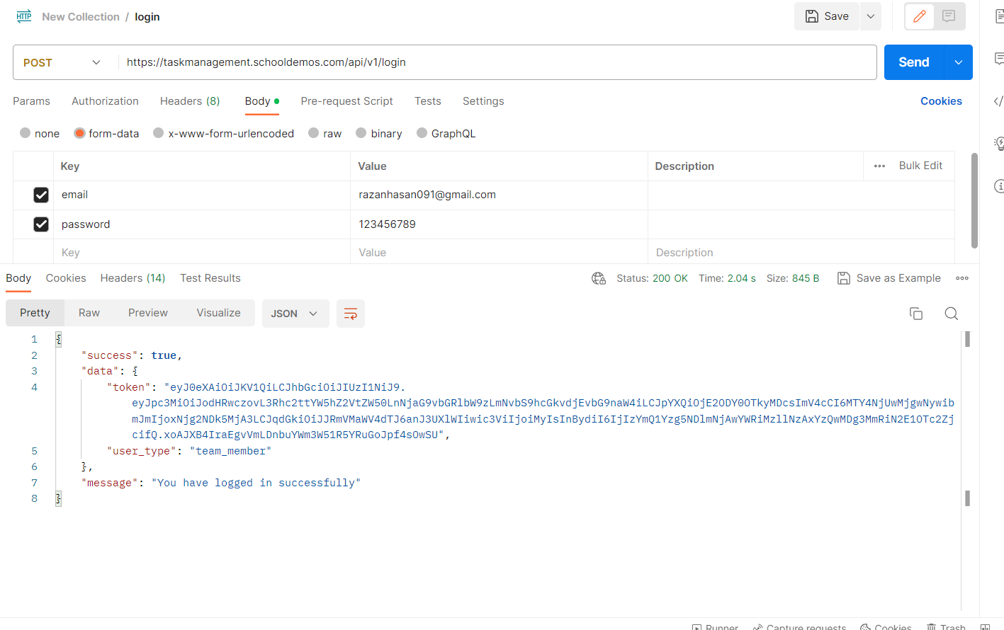

Slide 40
06
Challenges

Slide 41
Challenges in Backend
Find online server support Laravel to upload backend
Version of project

Slide 42
Conclusion.

Slide 43
Thanks !

